Slide 1
RESEARCH PAPER SUMMARIZER
Team Name-Koders
Theme-ML

Slide 2
Problem
Statement
Writing a research paper takes in a lot of efforts. But according to a study in 2007 half the academic papers are read only by their authors and journal editors.
One reason for this is the research papers being so lengthy that the general public never read it.
Getting the real context of such research papers is often tedious and time consuming.
Which is why we are making a Research Paper Summarizer WebApp.

Slide 3
All the user has to do is provide a link to the document.
Efficiently extracts meaningful information from lengthy documents and provide to the user just on one click.
Our Web App provides the user with 2 summarizers. User can also select the number of lines he wants in the summary.
The summary is classified and stored in database for easy access.
OUR SOLUTION

Slide 4
Unique Selling Points
Our classifier accurately classifies and stores the summary in database providing easy and direct access to the users.
We offer 2 summarizers one based on word frequency and other using a graph model so that the user can choose based on his preference.
Also, currently working on developing an abstractive summarizer.
The graph based approach reduces the number of sentences in the original document by a significantly high percentage to generate the summary.

Slide 5
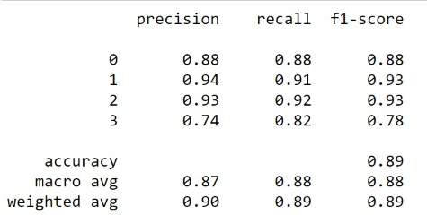
Evaluation and Results
Classifier accuracy-89%
Summarizer metric evaluation
ROUGE Type | System Name | Avg_ Recall | Avg_ Precision | Avg_ F-Score | Number of Reference Summaries
ROUGE-1 | DOC1 .txt | 0.3270 | 0.32000 | 0.32350 | 2
ROUGE-1 | DOC2 .txt | 0.3350 | 0.33000 | 0.33370 | 2
ROUGE-1 | DOC3 .txt | 0.3293 | 0.32000 | 0.32270 | 2

Slide 6
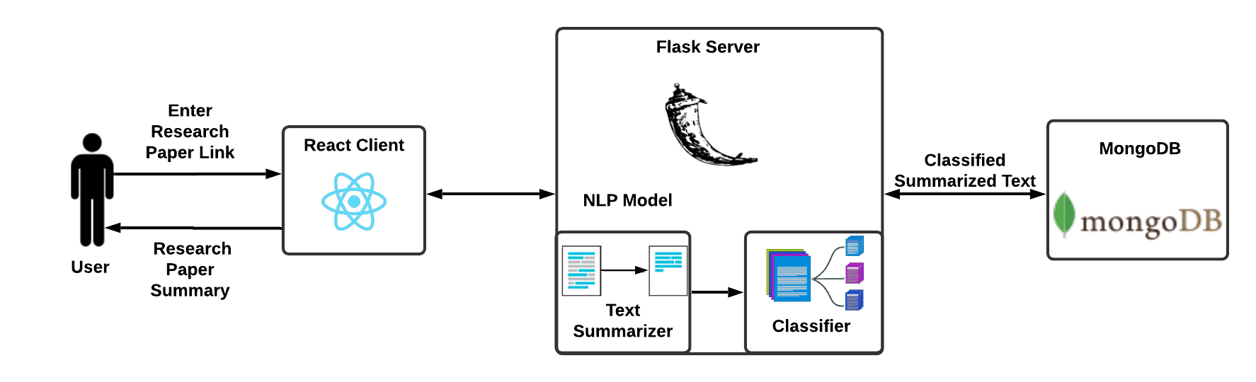
ARCHITECTURE

Slide 7





Tech Stack
WEB
TECHNOLOGIES
FLASK
REACT
NLP &
MACHINE
LEARNING

Slide 8
Future Scope
Creating a browser extension ,app for the same.
We aim to eventually extract figures,tables and images and links which will direct to the open access version of the cited sources.
Proofread the text.
Extract summary for regional languages.
Further improve the accuracy of the model.

